Slide 1
Software Engineering and Architecture
Composite Pattern

Slide 2
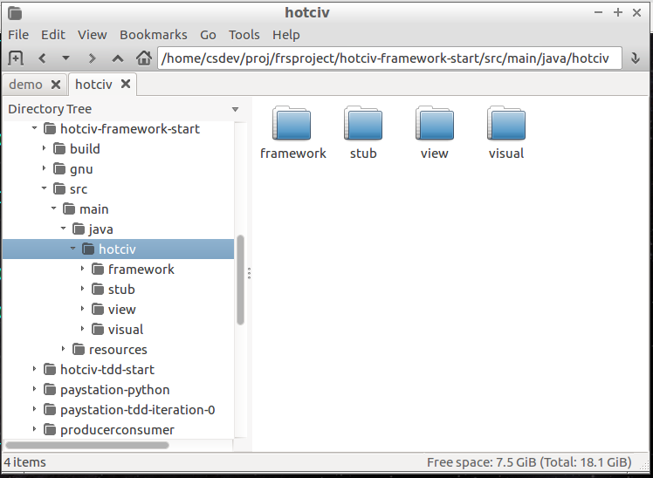
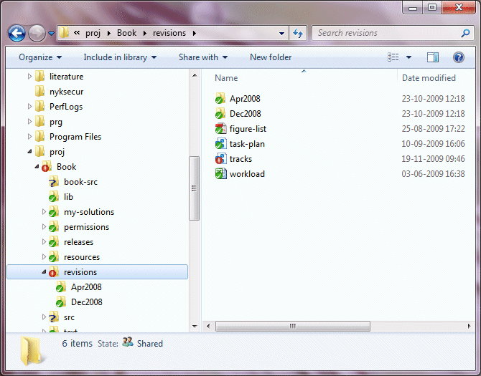
Part-Whole Structures
Hierarchical data structures pervade IT systems
  Folders (whole) and files (part) is a classic example

Slide 3
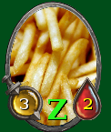
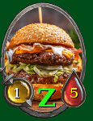

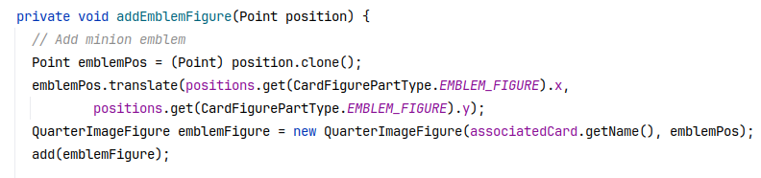
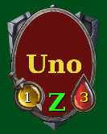
Gfx Part-Whole
HotStone CardFigure
  … is not a fixed image
    Health/attack changes
    Frame
    ‘Emblem’ image
    Active ‘Z’

Slide 4
How to design?
Using the model perspective (who/what) we focus on concepts in the domain:
  Who: Folder and File
  What: Very different things
    Folder: addFile, addFolder, removeFile, etc.
    File: open, close, getType, getSize, setReadOnly
Using a responsibility perspective (what/who) we instead focus on behavior:
  What: calculate size, move in structure, delete, set to read only
  Who: actually both folders and files…

Slide 5
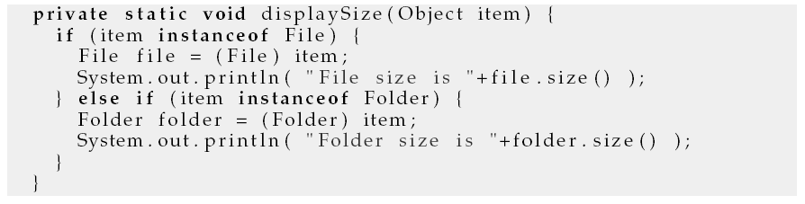
Model-Perspective
Design 1:
  Make disjoint classes as they are disjoint concepts
    class Folder {…} and class File {…}
But – will require a lot of casting…
This if section will appear in every shared operation!

Slide 6
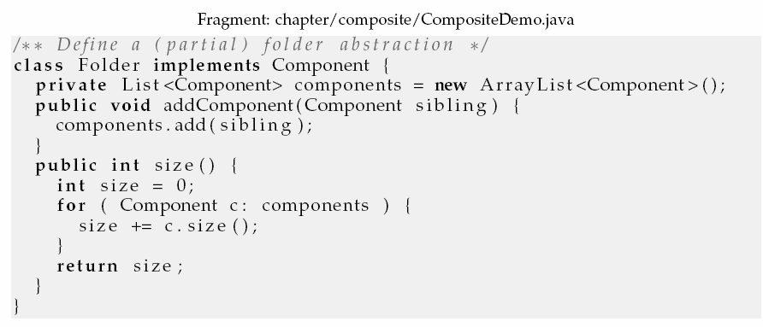
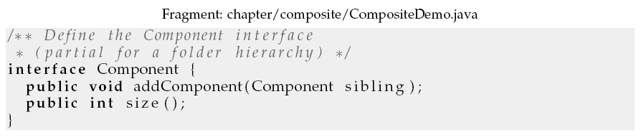
Responsibility-Perspective
Design 2:  Program to an Interface

Slide 7
Recursion…
Whereas:
class File implements Component
‘s size() method will just return its
size in bytes…
Notice that this is a recursive depth-first descent into the tree…

Slide 8
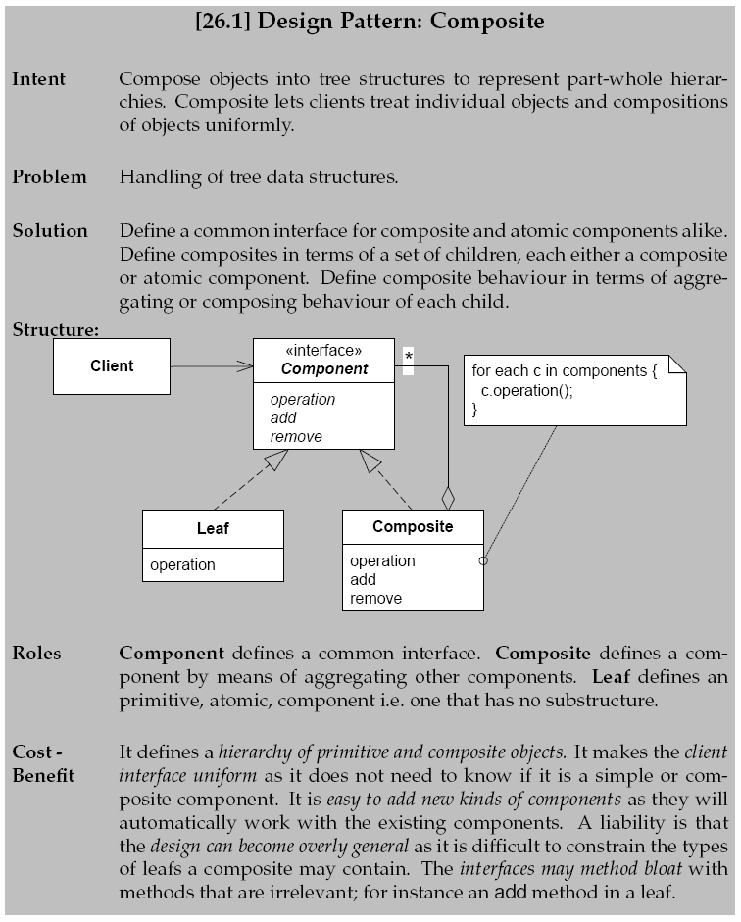
The Pattern

Slide 9
Benefits and Liabilities
Whole and part objects are treated identically
  Makes the client code much easier, avoiding a lot of testing on component types
Easy to add new types of components
  The Linux/Windows explorer can browse and manipulate any file, even those not known at deploy time.
Nonsense methods
  addComponent(Component c) is nonsense for Leaf/File
  i.e. Cohesion is low for Leaf ☹
    May throw ‘not supported exception’ or exhibit null behavior

